Slide 1

Peanut Weed
Control Update - 2015
Eric P. Prostko, Ph.D.
Professor and Extension Weed Specialist
Department of Crop & Soil Sciences

Slide 2

It Ain’t Always Herbicides

Slide 3
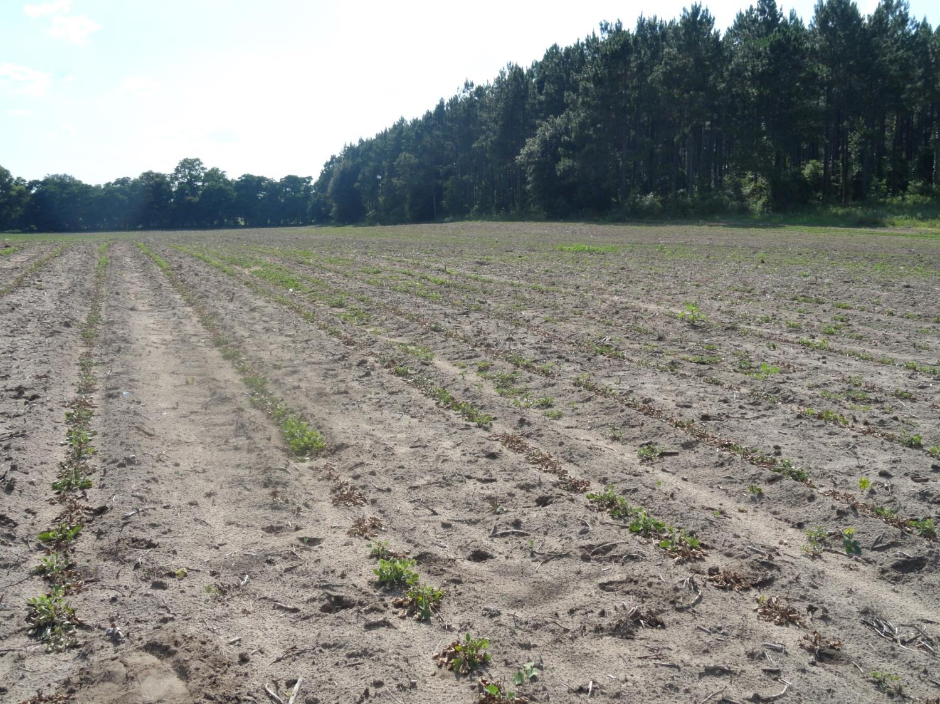
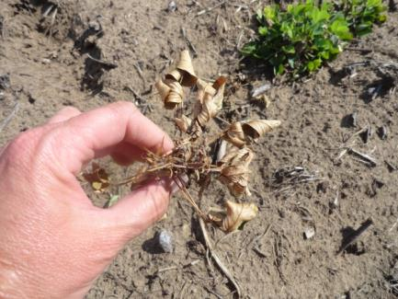
A Herbicide Problem??

Slide 4
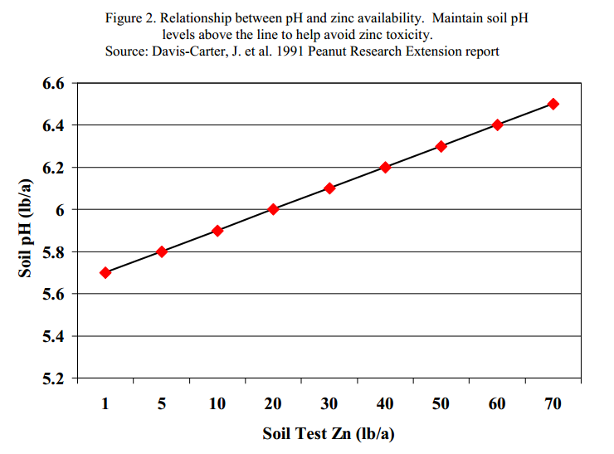
pH = 4.9
Zn = 46 lb/A

Slide 5
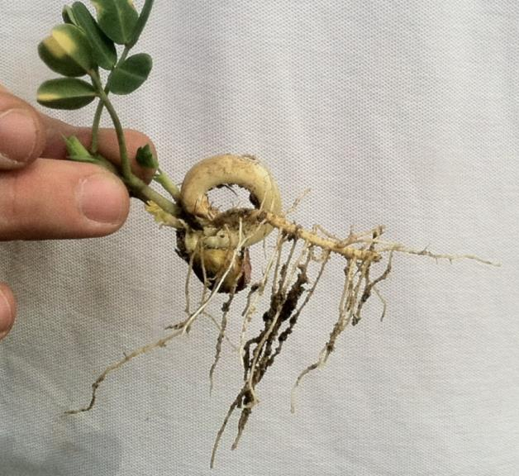
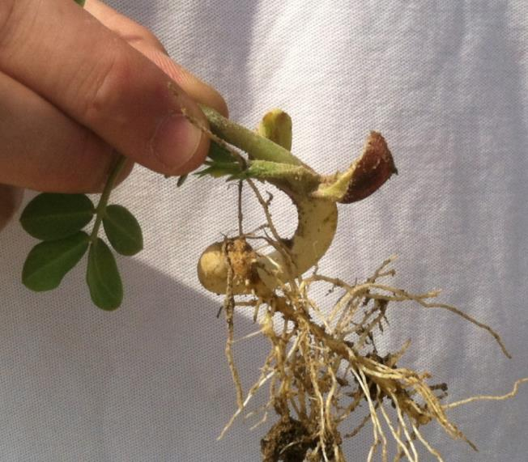
J-Rooting Peanuts – No Herbicides Applied
GA-06G, Planted May 5, 2014, Pictures May 20

Slide 6
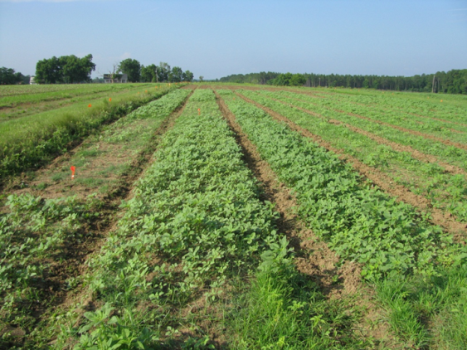
Starting Clean
If you are getting ready to plant and get to the field and have pigweed > 6” tall …………
Park the planter and sprayer
Go get your mower, disk, and/or bottom plow!!!!!!!!

Slide 7
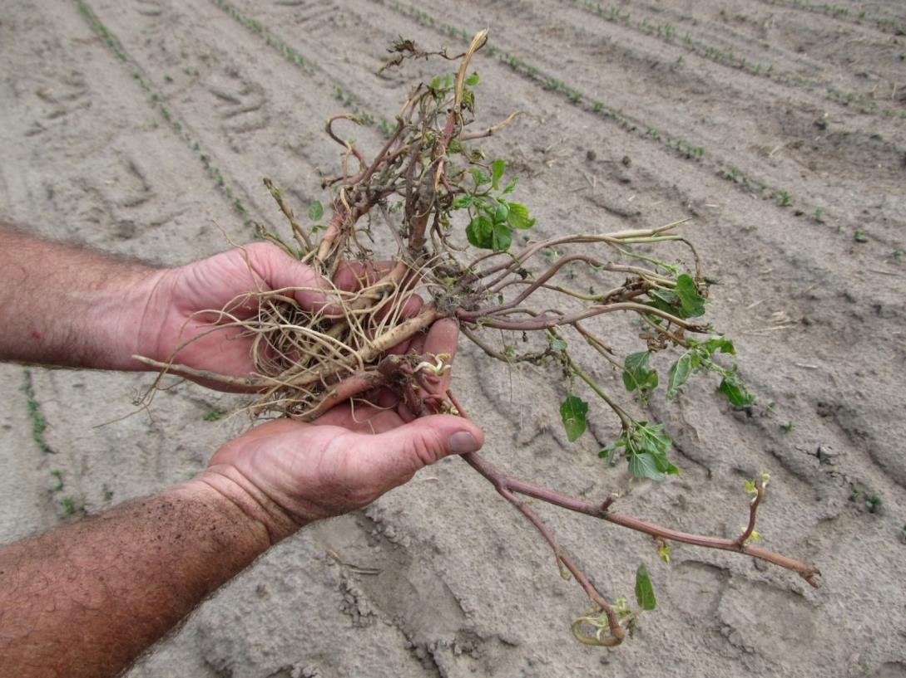
Did you really start clean????
A disk may not be good enough!

Slide 8
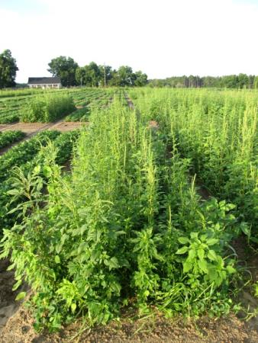
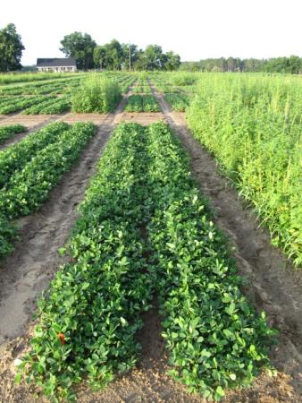
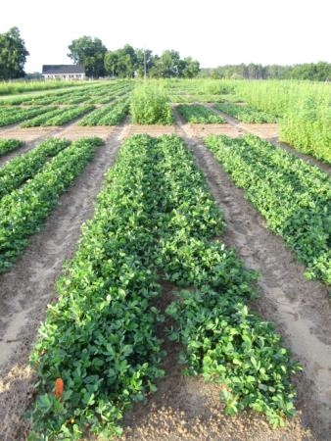
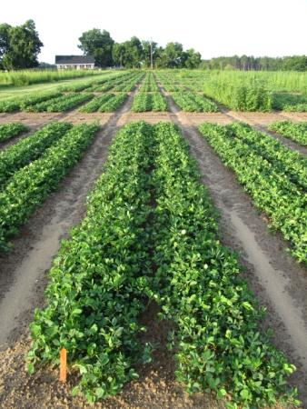
Peanut Weed Control Programs (2014) – I
Valor + Strongarm + Prowl fb Cadre, Cobra, or Blazer
NTC
Prowl H₂0 @ 34 oz/A - PRE
Valor @ 3 oz/A – PRE
Strongarm @ 0.23 oz/A – PRE
Cadre @ 4 oz/A – POST (36 DAP)
Dual Magnum @ 16 oz/A – POST ( 36 DAP)
Prowl H₂0 @ 34 oz/A - PRE
Valor @ 3 oz/A – PRE
Strongarm @ 0.23 oz/A – PRE
Cobra @ 12.5 oz/A – POST (36 DAP)
Dual Magnum @ 16 oz/A – POST ( 36 DAP)
2,4-DB @ 18 oz/A – POST (36 DAP)
Prowl H₂0 @ 34 oz/A - PRE
Valor @ 3 oz/A – PRE
Strongarm @ 0.23 oz/A – PRE
Ultra Blazer @ 24 oz/A – POST (36 DAP)
Dual Magnum @ 16 oz/A – POST ( 36 DAP)
2,4-DB @ 18 oz/A – POST (36 DAP)
PE-02-14
June 26
52 DAP

Slide 9
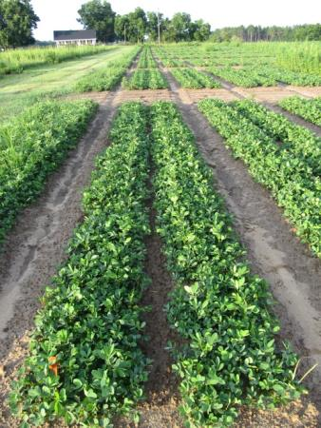
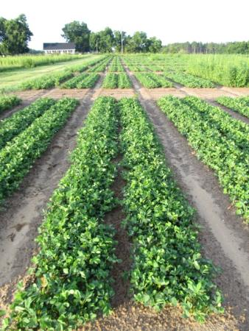
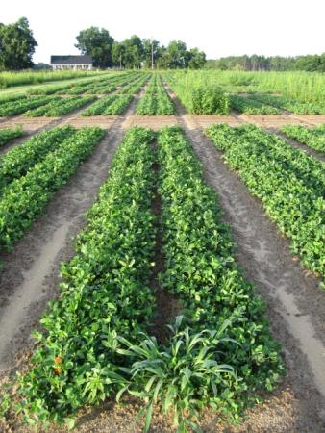
Peanut Weed Control Programs (2014) – II
Prowl fb Gramoxone fb Cadre, Cobra, or Blazer
NTC
Prowl H₂0 @ 34 oz/A – PRE
Gramoxone @ 12 oz/A – EPOST (22 DAP)
Storm @ 16 oz/A – EPOST (22 DAP)
Dual Magnum @ 16 oz/A – EPOST ( 22 DAP)
Cadre @ 4 oz/A – POST (36 DAP)
Dual Magnum @ 16 oz/A – POST ( 36 DAP)
Prowl H₂0 @ 34 oz/A - PRE
Gramoxone @ 12 oz/A – EPOST (22 DAP)
Storm @ 16 oz/A – EPOST (22 DAP)
Dual Magnum @ 16 oz/A – EPOST ( 22 DAP)
Cobra @ 12.5 oz/A – POST (36 DAP)
Dual Magnum @ 16 oz/A – POST ( 36 DAP)
2,4-DB @ 18 oz/A – POST (36 DAP)
Prowl H₂0 @ 34 oz/A - PRE
Gramoxone @ 12 oz/A – EPOST (22 DAP)
Storm @ 16 oz/A – EPOST (22 DAP)
Dual Magnum @ 16 oz/A – EPOST ( 22 DAP)
Ultra Blazer @ 24 oz/A – POST (36 DAP)
Dual Magnum @ 16 oz/A – POST ( 36 DAP)
2,4-DB @ 18 oz/A – POST (36 DAP)
PE-02-14
June 26
52 DAP

Slide 10
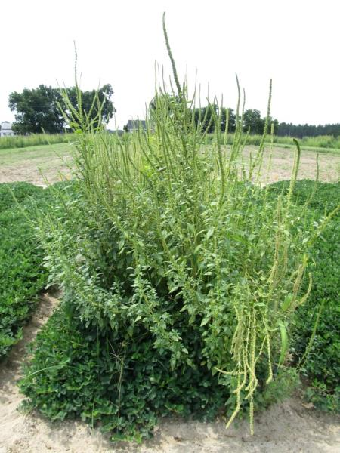
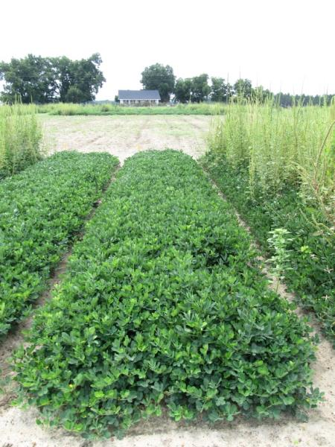
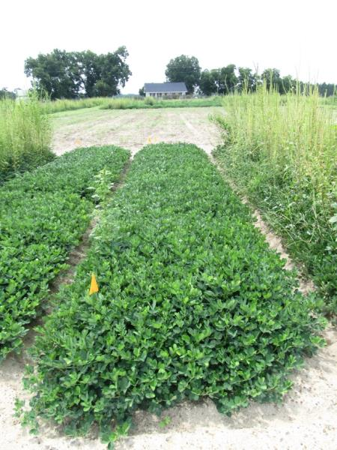
Peanut Weed Control Programs Without Valor - 2014
NTC
Prowl H₂0 @ 32 oz/A (PRE)
Gramoxone @ 12 oz/A (17 DAP)
Storm @ 16 oz/A (17 DAP)
Dual Magnum @ 16 oz/A (17 DAP)
Cadre @ 4 oz/A (39 DAP)
Dual Magnum @ 16 oz/A (39 DAP)
Prowl H₂0 @ 32 oz/A (PRE)
Gramoxone @ 12 oz/A (17 DAP)
Storm @ 16 oz/A (17 DAP)
Warrant @ 48 oz/A (17 DAP)
NIS @ 0.25% v/v (17 DAP)
Cadre @ 4 oz/A (39 DAP)
Warrant @ 48 oz/A (39 DAP)
NIS @ 0.25% v/v (39 DAP)
PE-07-14
July 30
96 DAP

Slide 11

Warrant Label Change (Hopefully?)
Old Label
  Warrant may be applied postemergence to peanut at 1.25 to 2 quarts per acre after crop emergence and before flowering.
Proposed New Label?
  Warrant may be applied postemergence to peanut at 1.25 to 2 quarts per acre after crop emergence up through the R1 growth stage (beginning bloom). R1 ends as 50% of the plants in an area have a visible peg (R2).

Slide 12
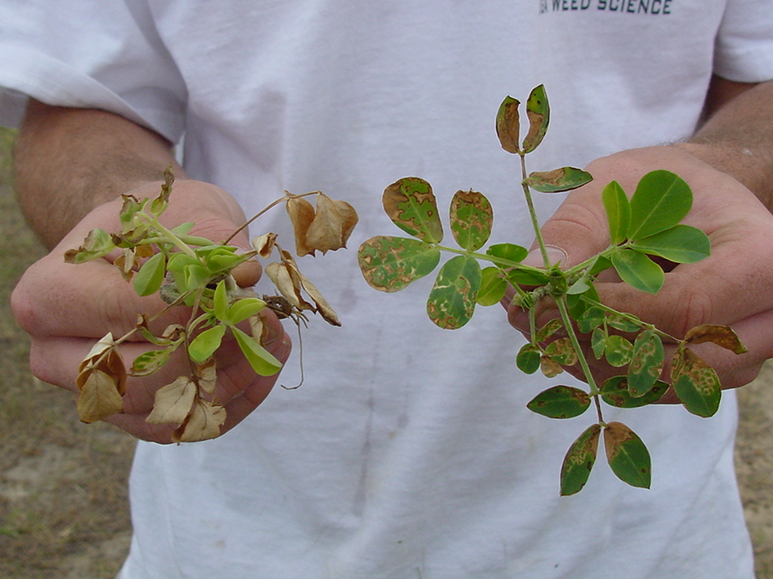
Treatments applied 6 DAC; Photo at 3 DAT
GA-02C
GI @ 8 oz/A +
NIS @ 0.25% v/v
GI @ 12 oz/A + Basagran @ 8 oz/A +
NIS @ 0.25% v/v

Slide 13
A Comparison of Irrigated Weed-Free Peanut Yields Between NTC and Gramoxone (12 oz/A) + Storm (16 oz/A) + Dual Magnum (16-21 oz/A) Treatments in Georgia, 2011-2014.
G + S + DM
(lbs/A)
PEA01-11 (GA-06G)
PEA01-12 (GA-06G)
PE-20-11 (GA-06G)
PE-01-12 (GA-06G)
PE-17-12 (GA-06G)
PE-02-13 (GA-06G)
PE-02B-13 (GA-09B)
PE-12-13 (GA-06G)
PE-13-13 (GA-06G)
PE-06-14 (GA-06G)
PE-06-14 (GA-09B)
PE-08-14 (GA-12Y)
6000 = 5802 (97%)
NTC (lbs/A)
n = 62

Slide 14
A Comparison of Irrigated Weed-Free Peanut Yields Between NTC and Gramoxone (12 oz/A) + Storm (16 oz/A) + Dual Magnum (16 oz/A) fb Cadre (4 oz/A) + Dual Magnum (16 oz/A) Treatments in Georgia, 2012-2014.
G + S + DM fb C + DM
(lbs/A)
6000 = 5862 (98%)
PE-06-12
PEA03-12
PE-12-13
PE-13-13
PE-06-14
PE-08-14
NTC (lbs/A)
n = 25

Slide 15
My Opinion
We are at the point now that 2,4-DB needs to be included with all of our 30-45 DAP POST treatments.
Why? Improved control of Palmer amaranth, sicklepod, and annual mg. Not really that expensive (~$2.75/A for 18 oz/A of 1.75 lb gal)
  Cadre + Dual or Warrant* + 2,4-DB
  Cobra or Ultra Blazer + Dual or Warrant* + 2,4-DB
  When Warrant is used, add NIS @ 0.25% v/v.
  No negative yield effect in 2014 field trials
*Assuming Warrant
label change

Slide 16
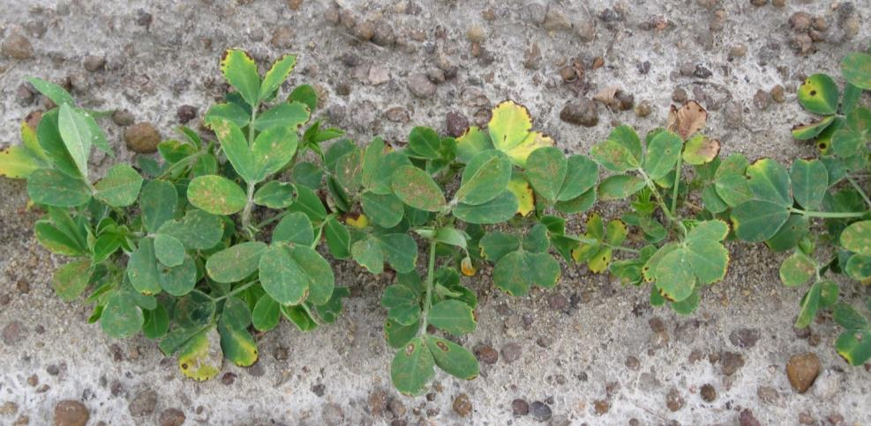
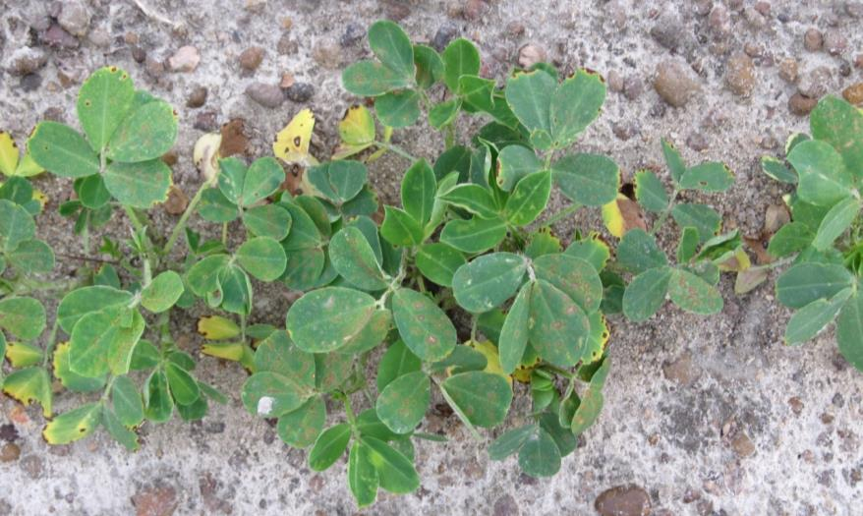
Cobra @ 12 .5 oz/A + Dual Magnum @ 16 oz/A + 2,4-DB @ 18 oz/A - 2 DAT
Cobra @ 12.5 oz/A + Warrant @ 48 oz/A + 2,4-DB @ 18 oz/A + NIS @ 0.25% v/v – 2 DAT

Slide 17
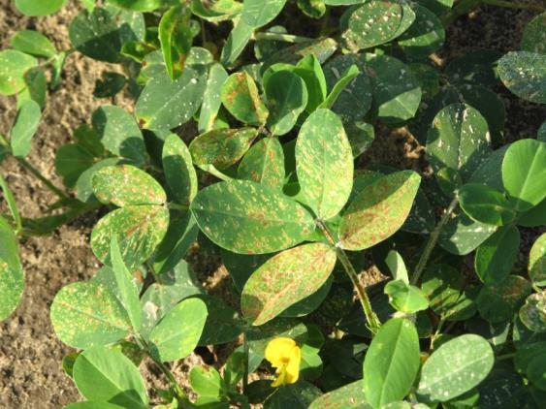
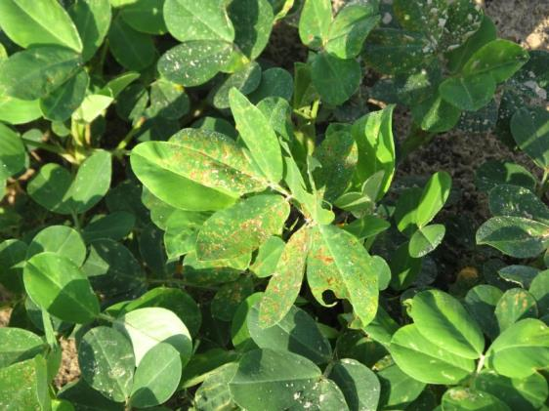
Cobra + 2,4-DB + Dual or Warrant - 2014
Cobra @ 12.5 oz/A
Dual Magnum @ 16 oz/A
2,4-DB @ 18 oz/A
3 DAT
Cobra @ 12.5 oz/A
Warrant @ 48 oz/A
2,4-DB @ 18 oz/A
NIS @ 0.25% v/v
3 DAT
PE-01B-14
June 20
3 DAT

Slide 18
Cadre (CD), Cobra (CB), 2,4-DB, Dual Magnum (DM), and Warrant (W) Effects on Peanut Yield - I
P = 0.2773
PE-01-14
Averaged over 2 timings
(29 and 44 DAP)

Slide 19
Cadre (CD), Cobra (CB), 2,4-DB, Dual Magnum (DM), and Warrant (W) Effects on Peanut Yield - II
P = 0.1605
PE-01B-14
Averaged over 2 timings
(34 and 44 DAP)

Slide 20

Tank-Mixtures
The Impossible Dream
17 POST herbicides
21 fungicides
16 insecticides
B or Mn
NIS or COC
7 am, 12 pm, 5 pm, 10 pm
91,392 possible combinations
4 reps = 365,568 plots
I do ~2640 plots/year
Thus, it would take me 138.5 years if I dropped everything else

Slide 21
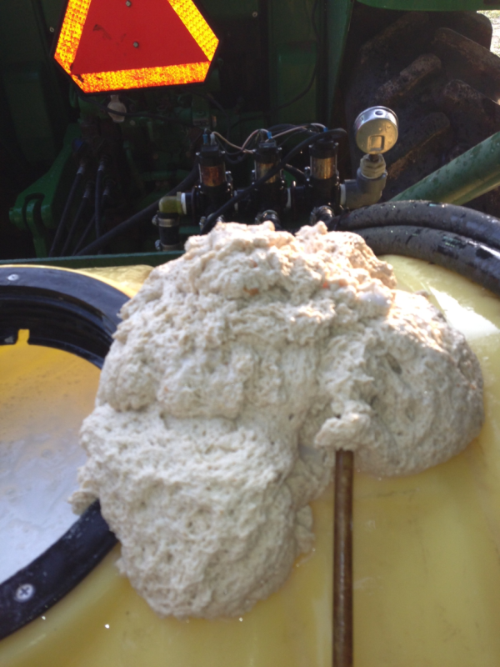
The Tank-Mixes Blues!
Reflex
Zidua
B-Moly
Glyphosate
Brandt Smart Trio
(N + S + B + Mn + Zn)
*Always pre-slurry dry formulations
in water before adding to tank!!!

Slide 22
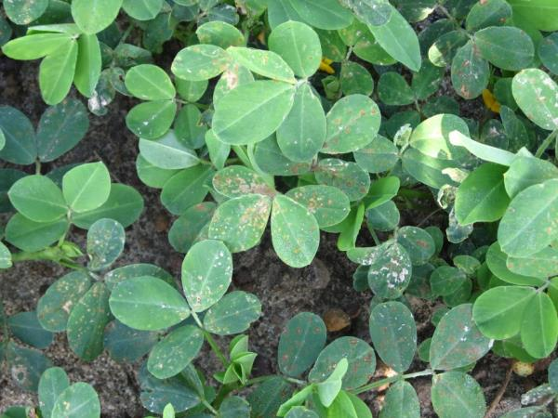
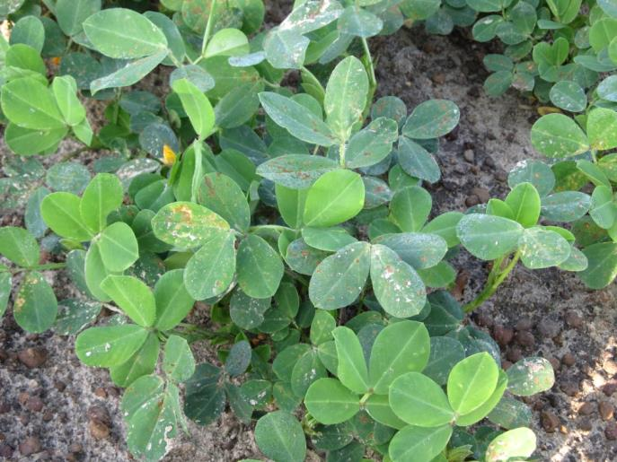
Select Max @ 16 oz/A + NIS @ 0.25% v/v fb Priaxor @ 6 oz/A + Boron @ 1 qt/A Applied 1 hour later
Photo = 3 DAT

Slide 23
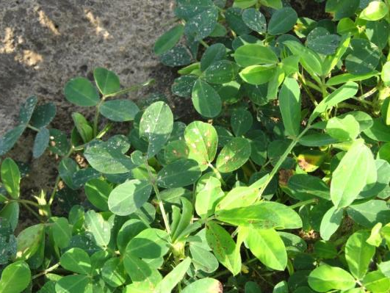
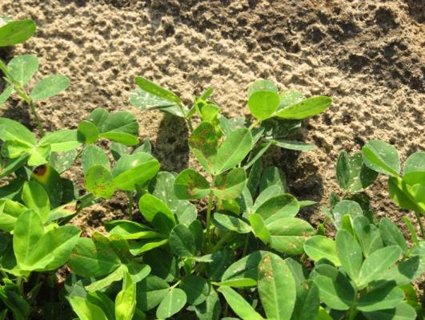
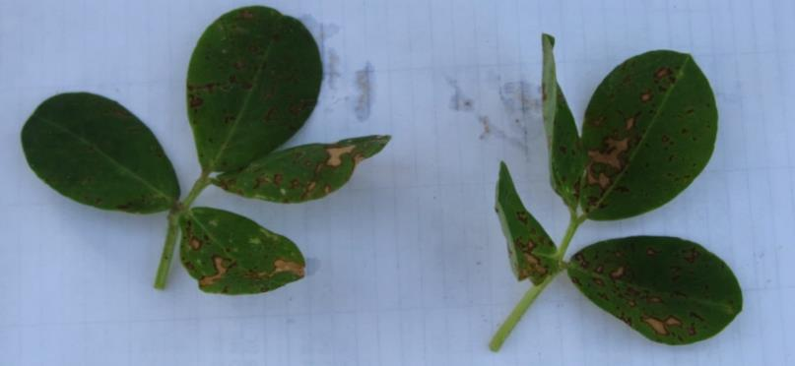
Cadre + 2,4-DB + Dual Magnum + Priaxcor – 3 DAT
PE-99-14
June 20
3 DAT

Slide 24
Peanut (GA-12Y) Yield Response (lb/A) to Odd Tank-Mixtures - 2014
LSD 0.10 = 197
CV = 2
C = Cadre @ 4 oz/A
D = Diamond @ 9 oz/A
AB = Absolute @ 5 oz/A
NIS = Induce @ 0.25% v/v
DB = 2,4-DB @ 18 oz/A
AC = Acephate @ 6 oz/A
DM = Dual Magnum @ 16 oz/A
PX = Priaxor @ 8 oz/A
Applied 34 DAP

Slide 25
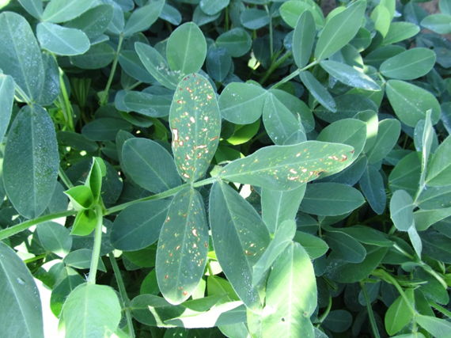



Dual Magnum, Warrant, Zidua, Fungicide Tank-Mixes 2014
No negative yield effects when tank-mixed with Tilt/Bravo, Abound, Fontelis, Provost, Priaxor, Artisan, Absolute.
More likely to see peanut leaf burn with Dual Magnum mixtures.

Slide 26

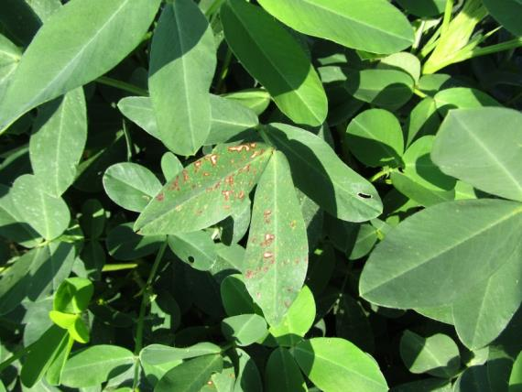
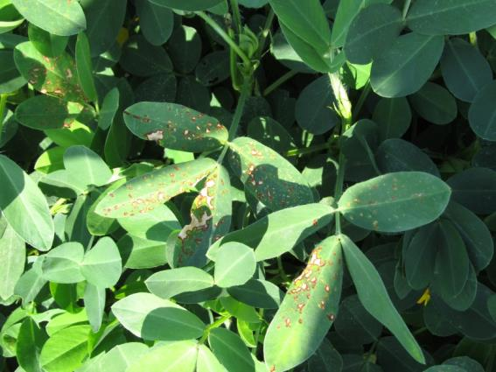
Dual Magnum @ 21 oz/A + Tilt/Bravo @ 32 oz/A – 7 DAT

Slide 27
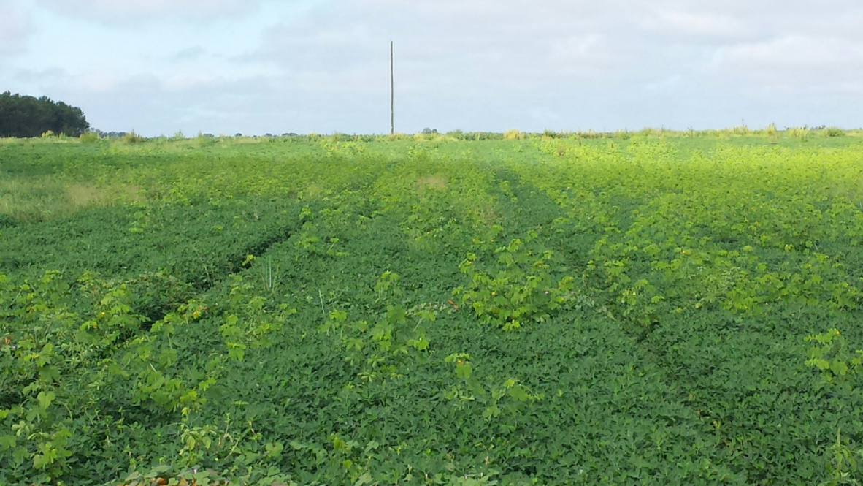
Our Next Resistance Issue or Timing Issue????
Terrell Co., September 2014

Slide 28
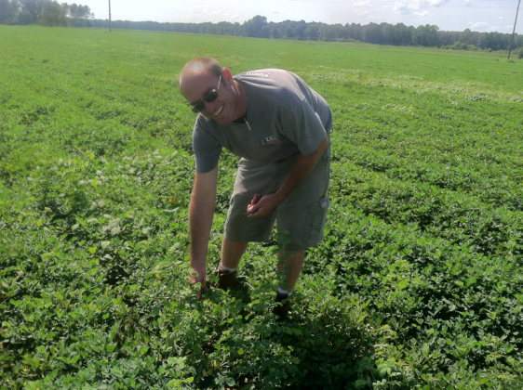
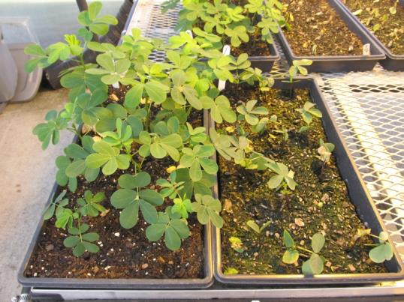
Sicklepod Survey
Fall 2014
Sicklepod seed collected from
  Berrien, Colquitt, Decatur, Dooly, Early, Evans, Pierce, Sumter, Tattnall, Tift, Terrell
29 populations

Slide 29
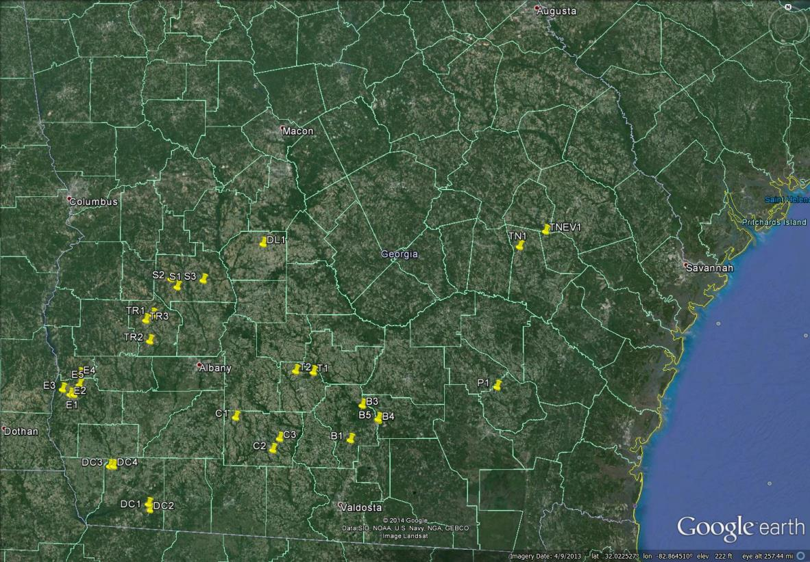
2014 Sicklepod Seed Survey

Slide 30
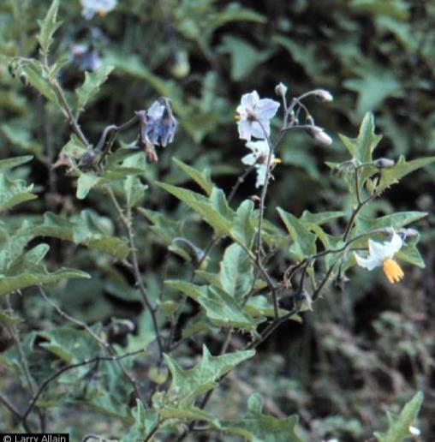
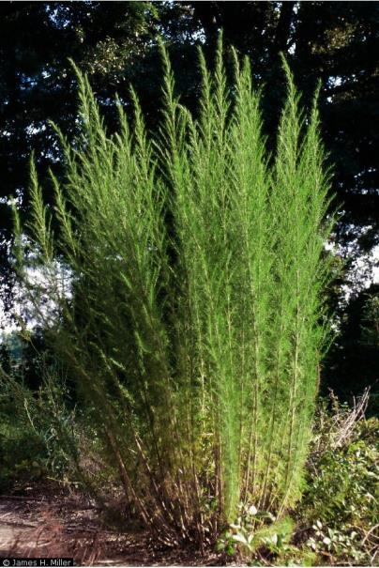
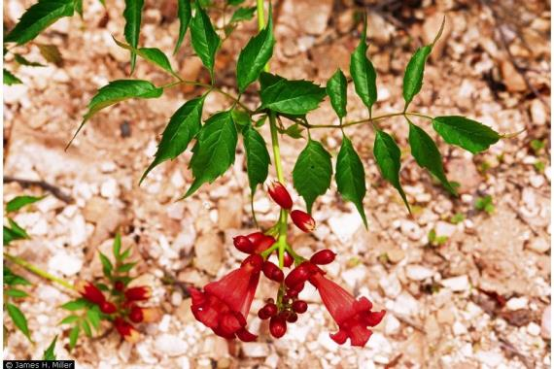
Perennial Weeds in Peanut - I
horsenettle
dogfennel
trumpetcreeper

Slide 31
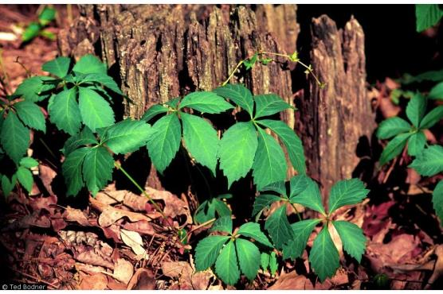
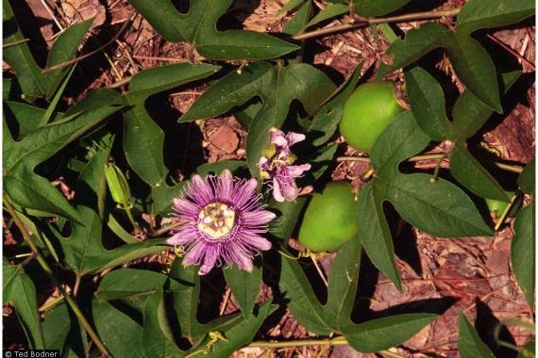
Perennial Weeds in Peanut - II
Virginia creeper
Maypop passionflower
Will take a few years to get under control
Fall applications of glyphosate
After digging but 2 weeks before 1st frost
Long-term program

Slide 32


New Labels 2016?
Zidua 85WG = pyroxasulfone (BASF)
Anthem Flex 4SE = Zidua + Aim (FMC)
  3.733 lbs Zidua + 0.267 lbs Aim
POST
With Gramoxone and/or Cadre
UGA will not support PRE use
  Why? No 2X safety margin

Slide 33
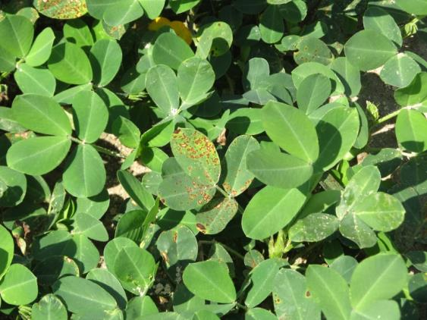
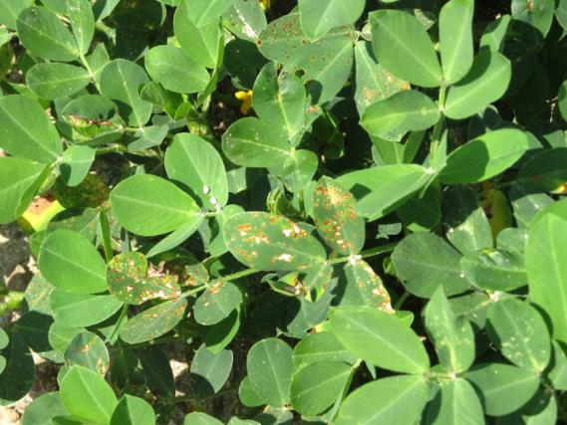
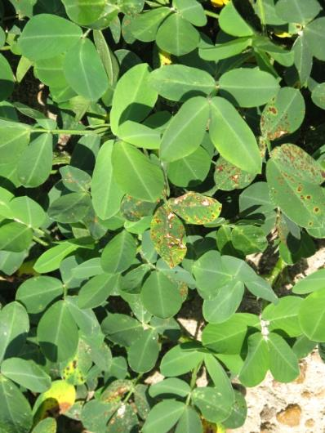
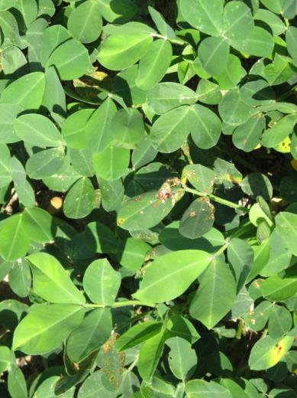

Anthem Flexx Injury from POST Apps
PE-12B-14
June 19

Slide 34
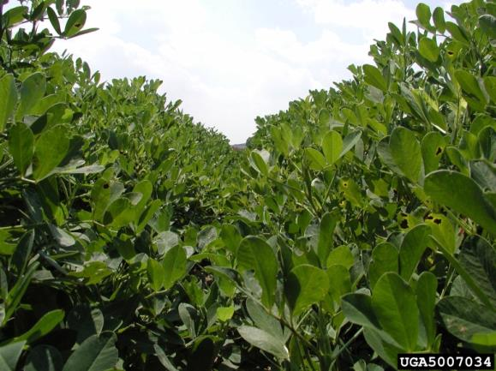

What do the top growers do?
2013 Georgia Peanut Achievement Club Winners
10 growers
6283 lb/A average yield
  GA State Avg. = 4430 lb/A
10/10- irrigated
7/10 – bottom plow
10/10 – twin rows
Rotation (Peanut)
  1-4 years = 2/10
  1-3 years = 8/10
Herbicides
  9/10 – Sonalan
  10/10 – Valor
  3/10 – Dual
  9/10 – Cadre
  3/10 – 2,4-DB
  1/10 – Prowl
  2/10 - Strongarm

Slide 35
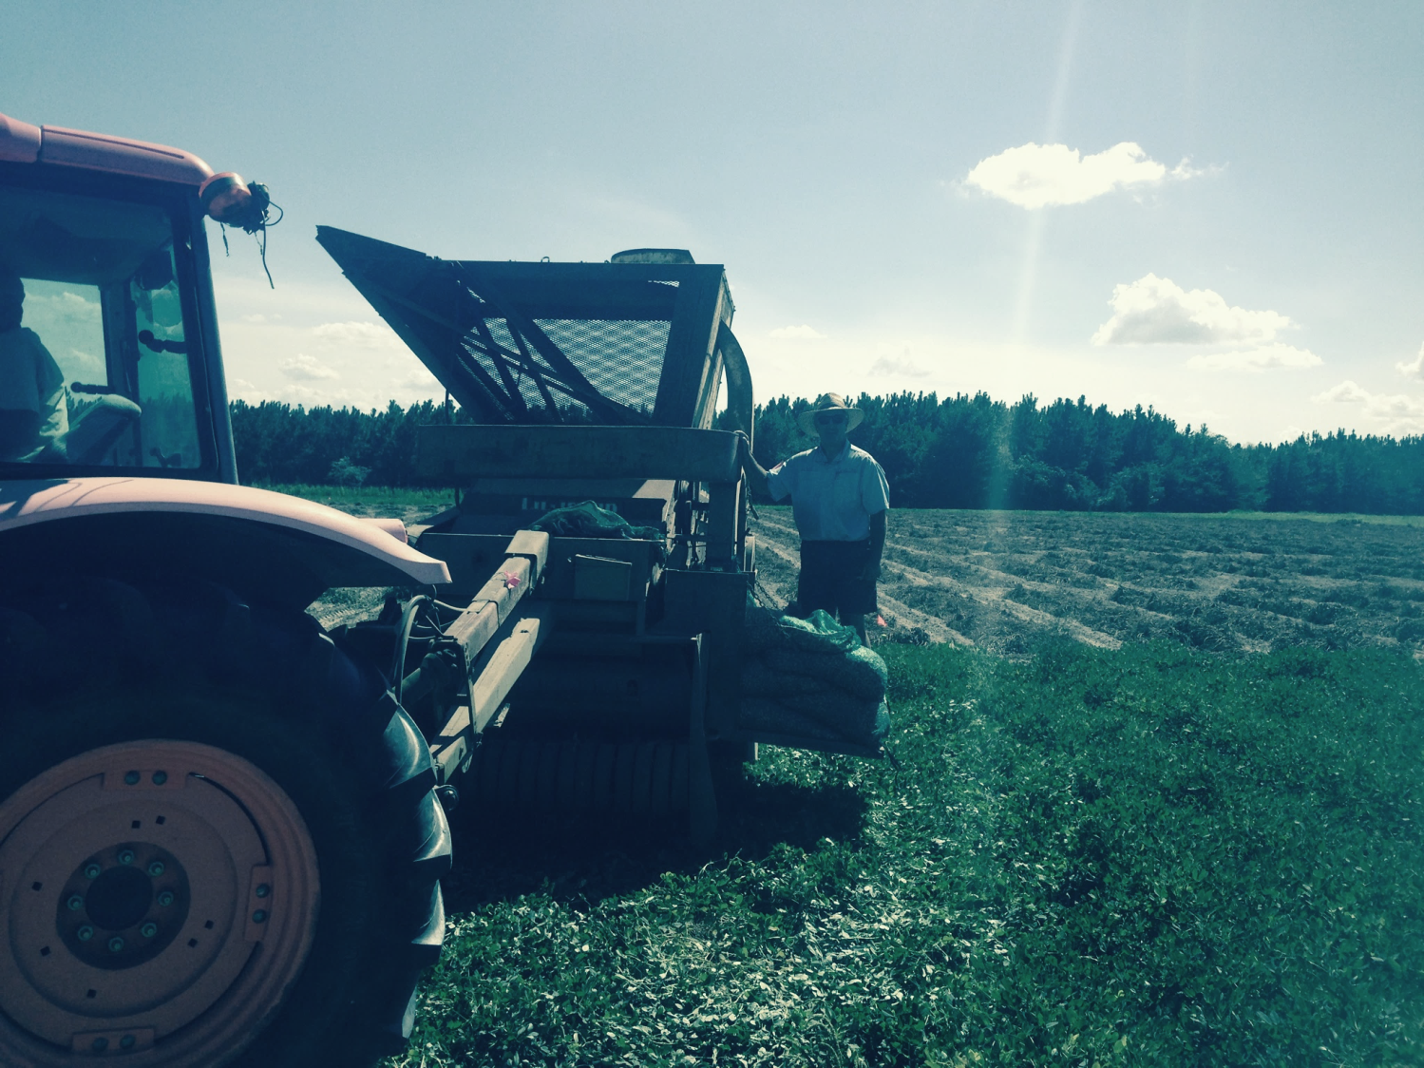

Questions???
eprostko@uga.edu
www.gaweed.com

